Slide 1
Destination Dashboard
A streamlined travel experience
Team 14 : Piotr Dudek, Adil Hussain, Ismael Mercado, Victoria Lee
Notes:
Speaker notes test

Slide 2
Elevator pitch

Slide 3



Concept
Destination Dashboard is for people looking to explore new and unique places as well as enjoy local cuisine at any given city with the option to find foods based on dietary needs.

Slide 4
Who is the user?
As a frequent traveler, I want to input my destination upon arrival and be presented with basic background information, popular attractions and restaurants in the area so that I can enjoy my stay as soon as I land.

Slide 5
Why?
Identified issues
Often forget to pack the right things to enjoy the trip
Unfamiliar with food and restaurants in new cities
Significant time spent planning a trip

Slide 6
Demo
DEMO !

Slide 7
How it all came together

Slide 8
Timeline Overview
API Test Complete
Complete dashboard display .js code
food.js complete
Complete place.js
Push final repo, readme, assets
Start food.js and place.js dev
Complete project blueprint
API research
Start weather.js
Start dashboard development
Skeleton code setup
Base code complete:
Wireframe development
UI + brand development
Combine code and team debug session
Presentation deck
HTML/CSS/Bootstrap/UI side development
API/JavaScript development
Team development checkpoint (class)

Slide 9
Transform issues into features
Dashboard:
Providing an overview of searched city
Somewhere to Go:
Supporting user with ideas of places to visit
Something to Eat:
Inspire users with local food selections

Slide 10



API Research and implementation
Information used
Weather
Temperature
Longitude
Latitude
.png icon
Restaurants
Images
Rating
Address
Points of interest
Images
Address
Rating
Country

Slide 11
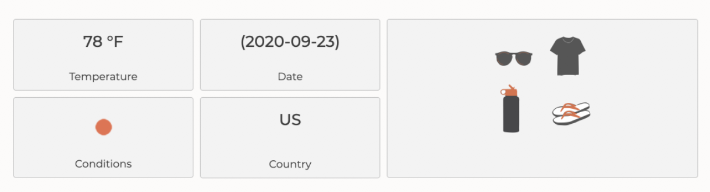
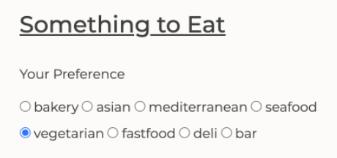
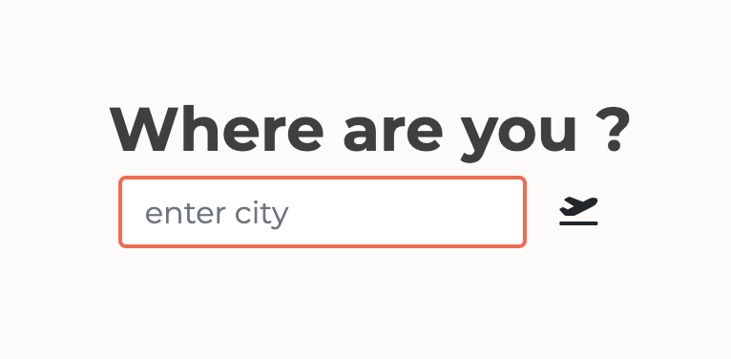
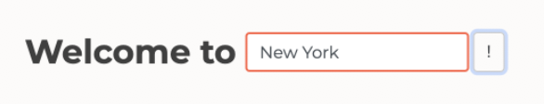
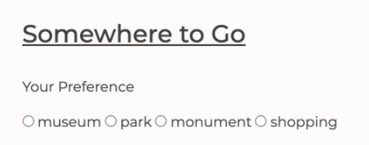
Pseudo Code Map
User experience
Display data
Passing data
API
Destination Dashboard elements
Place API
Somewhere to Go
User Input
Weather API
Dashboard
Something to Eat
Food API

Slide 12
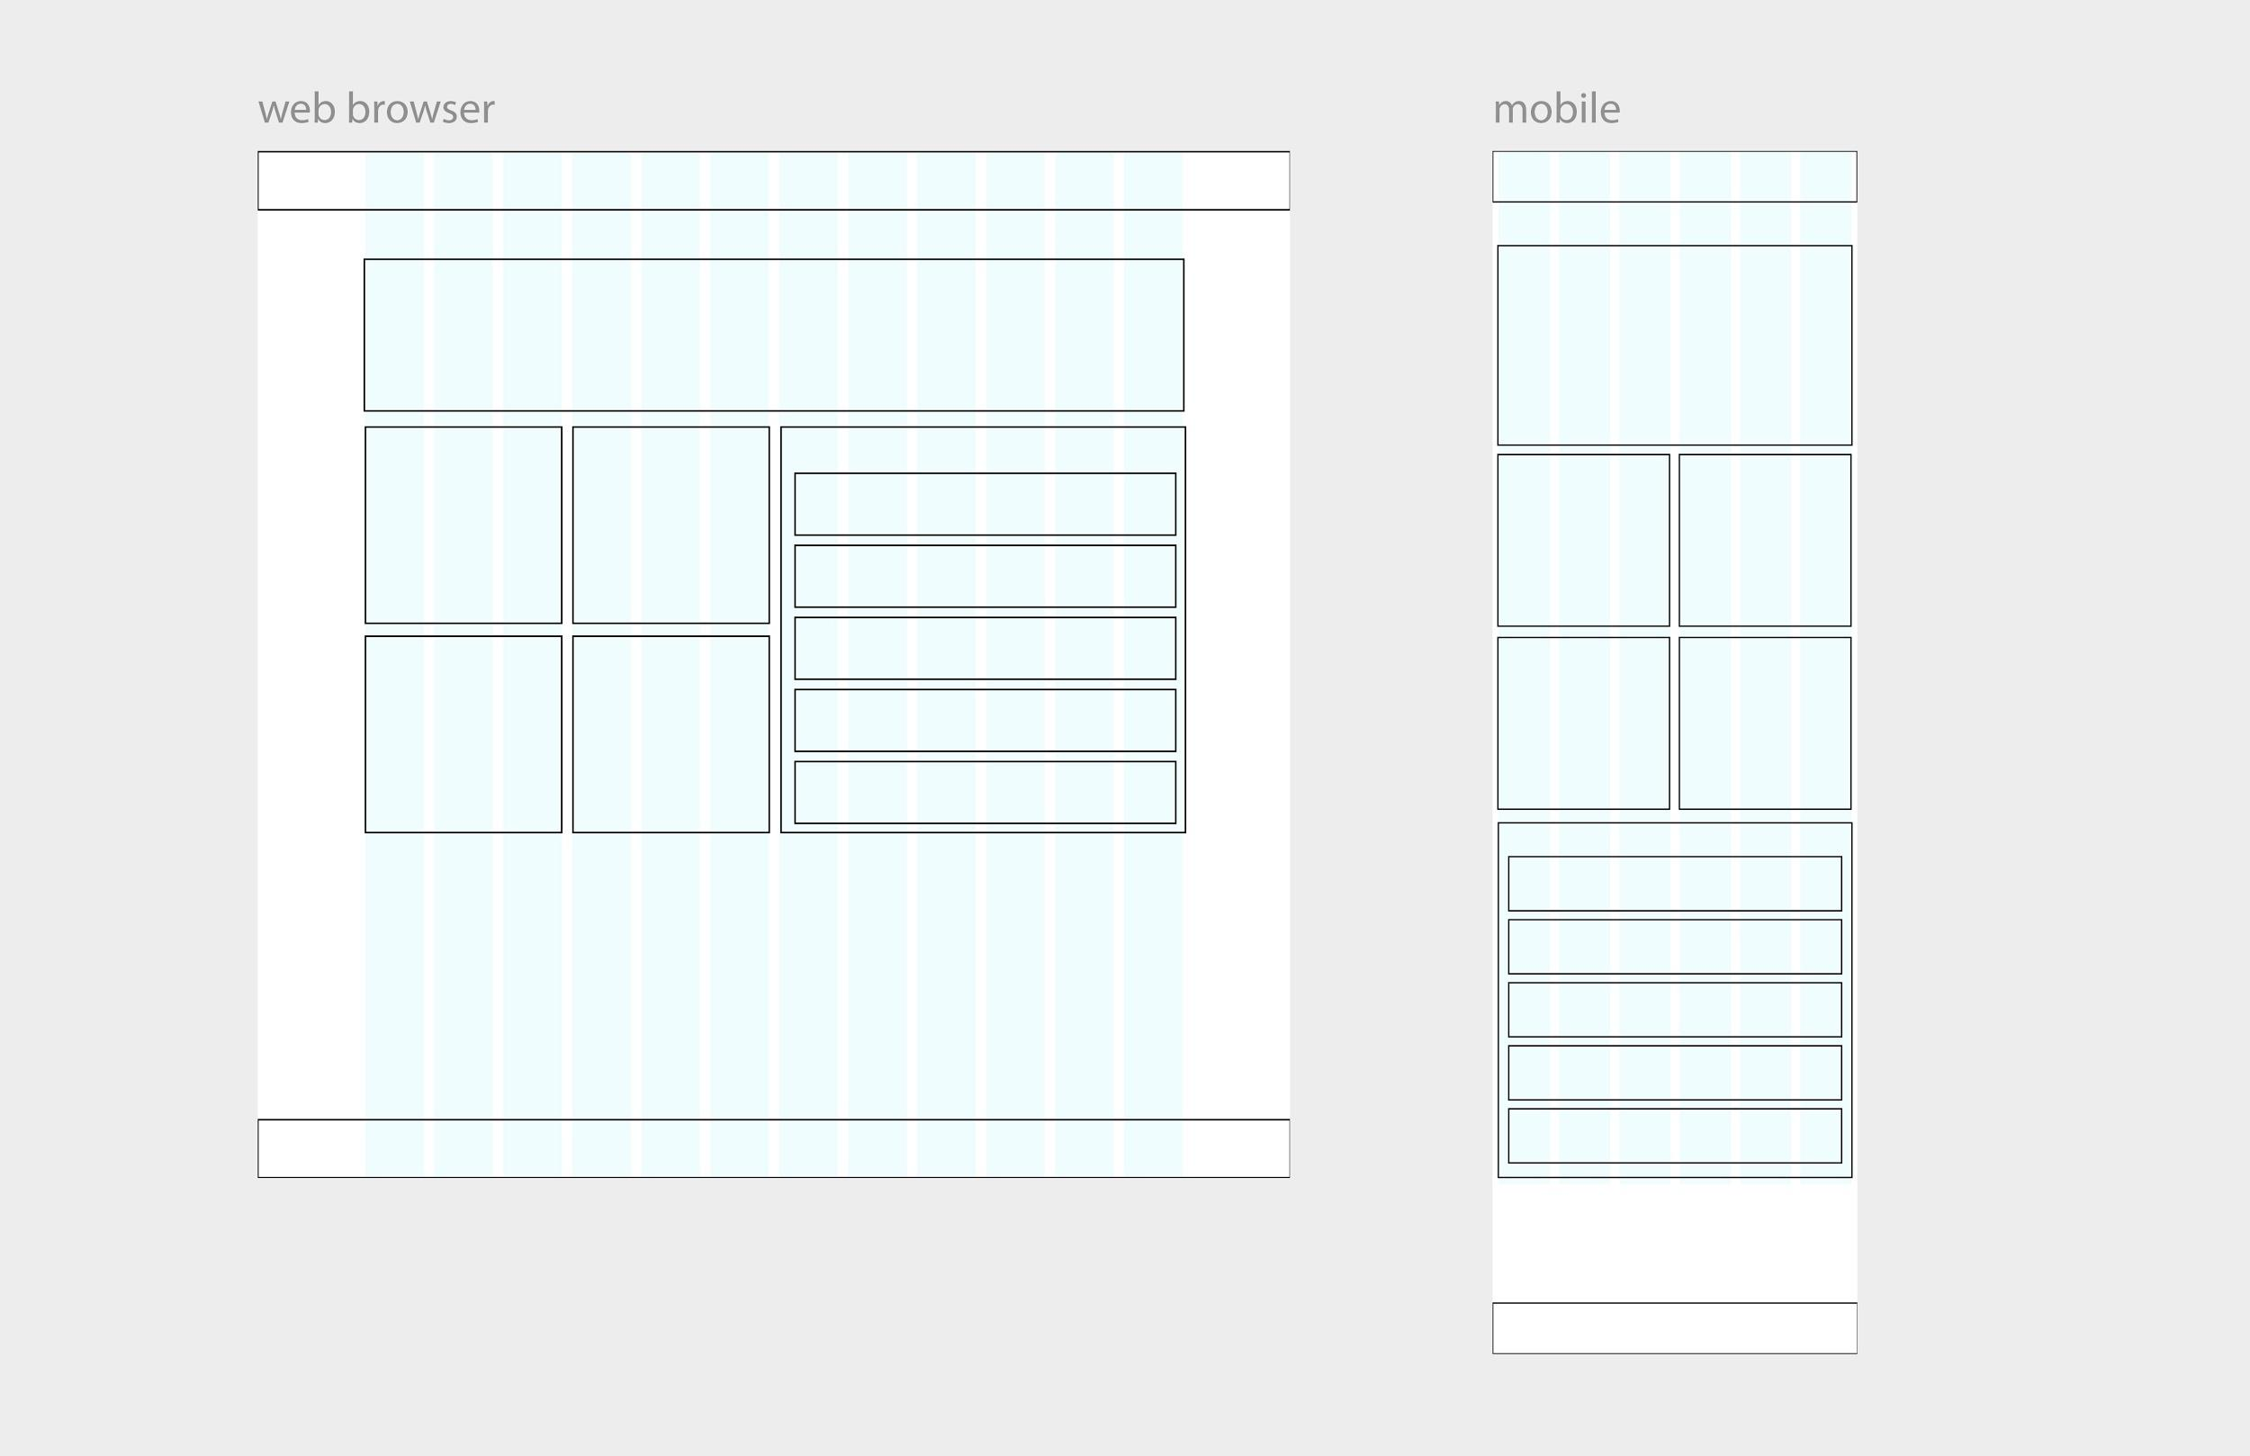
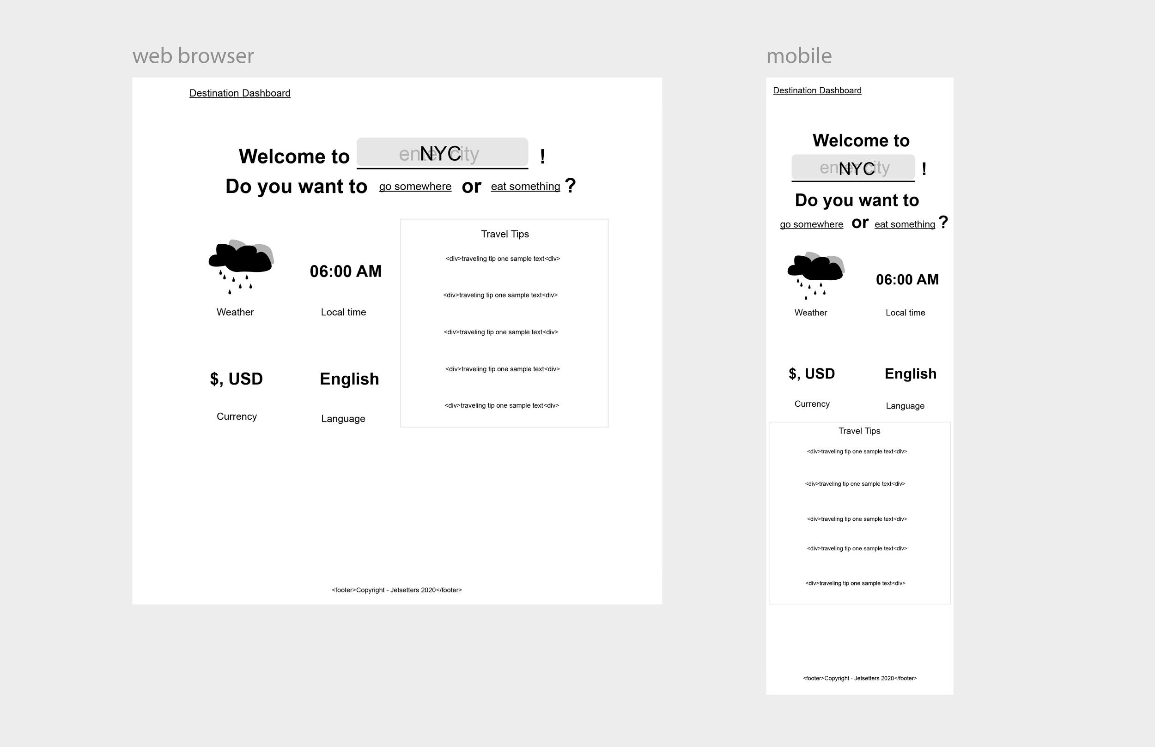
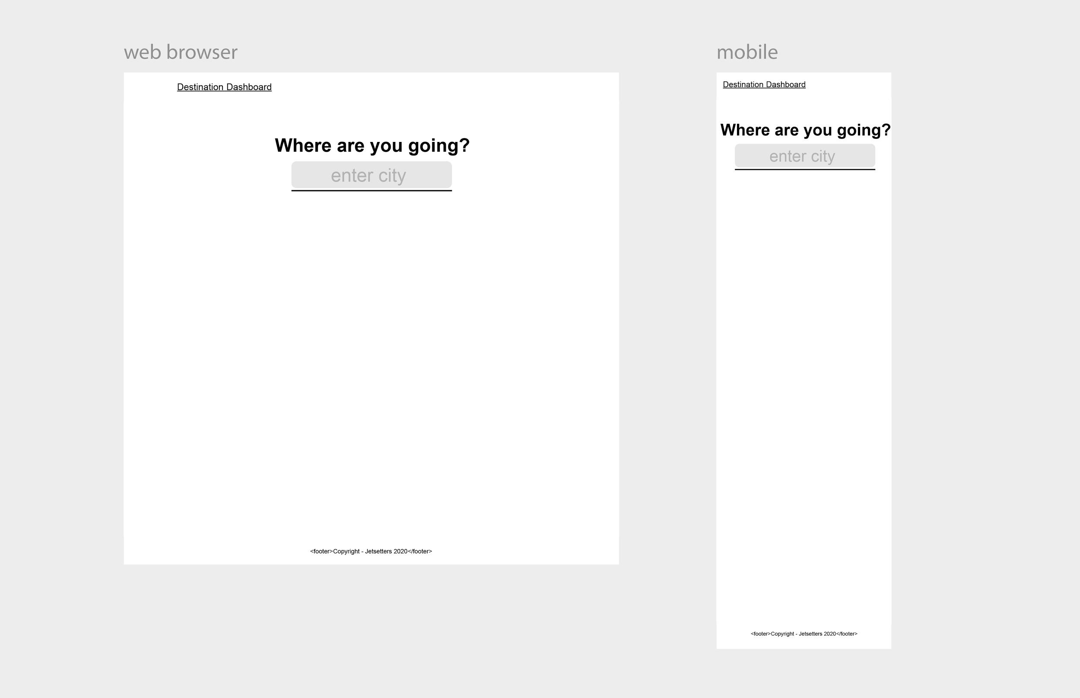
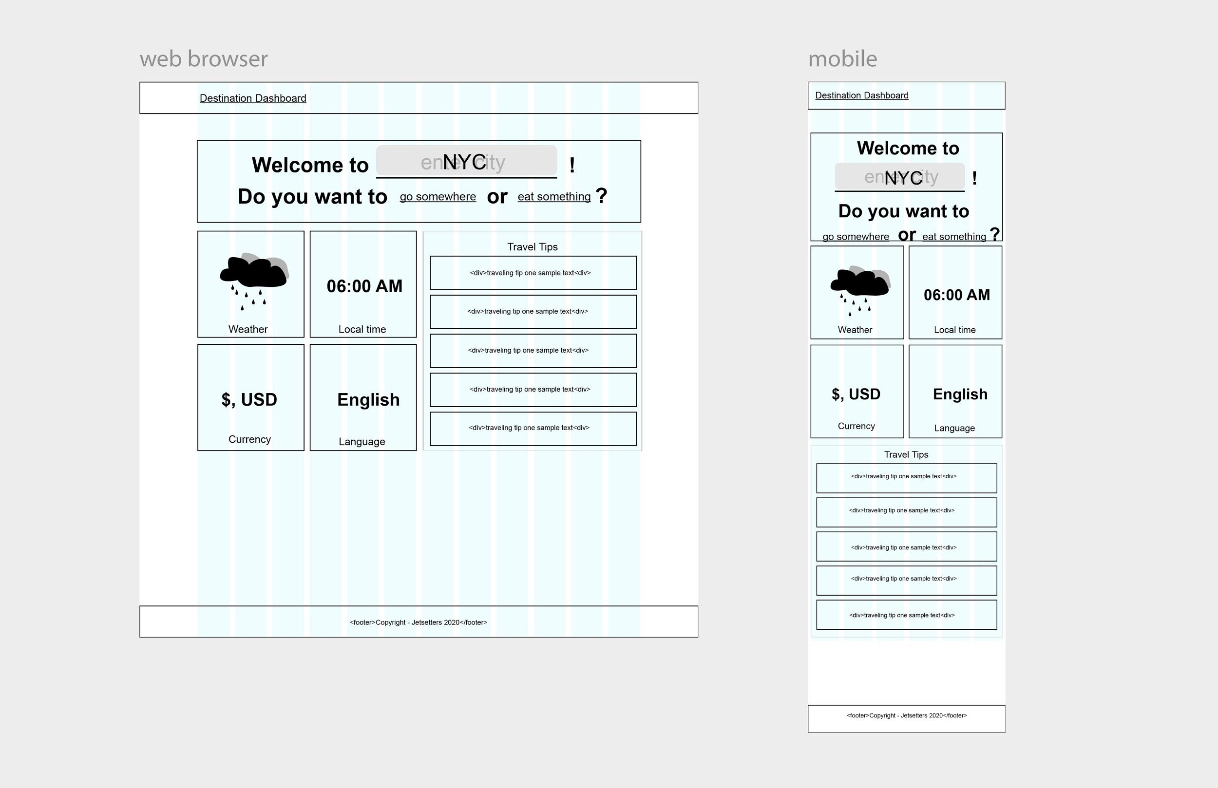
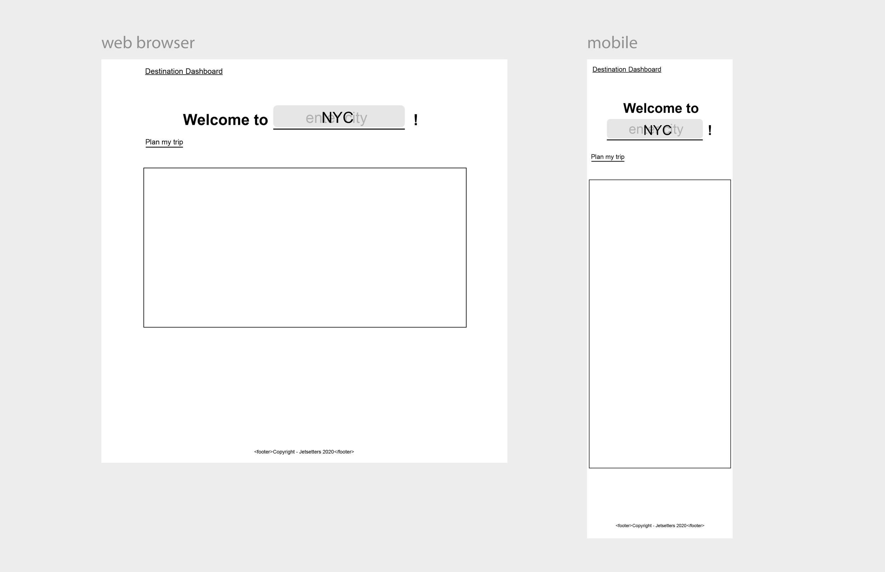
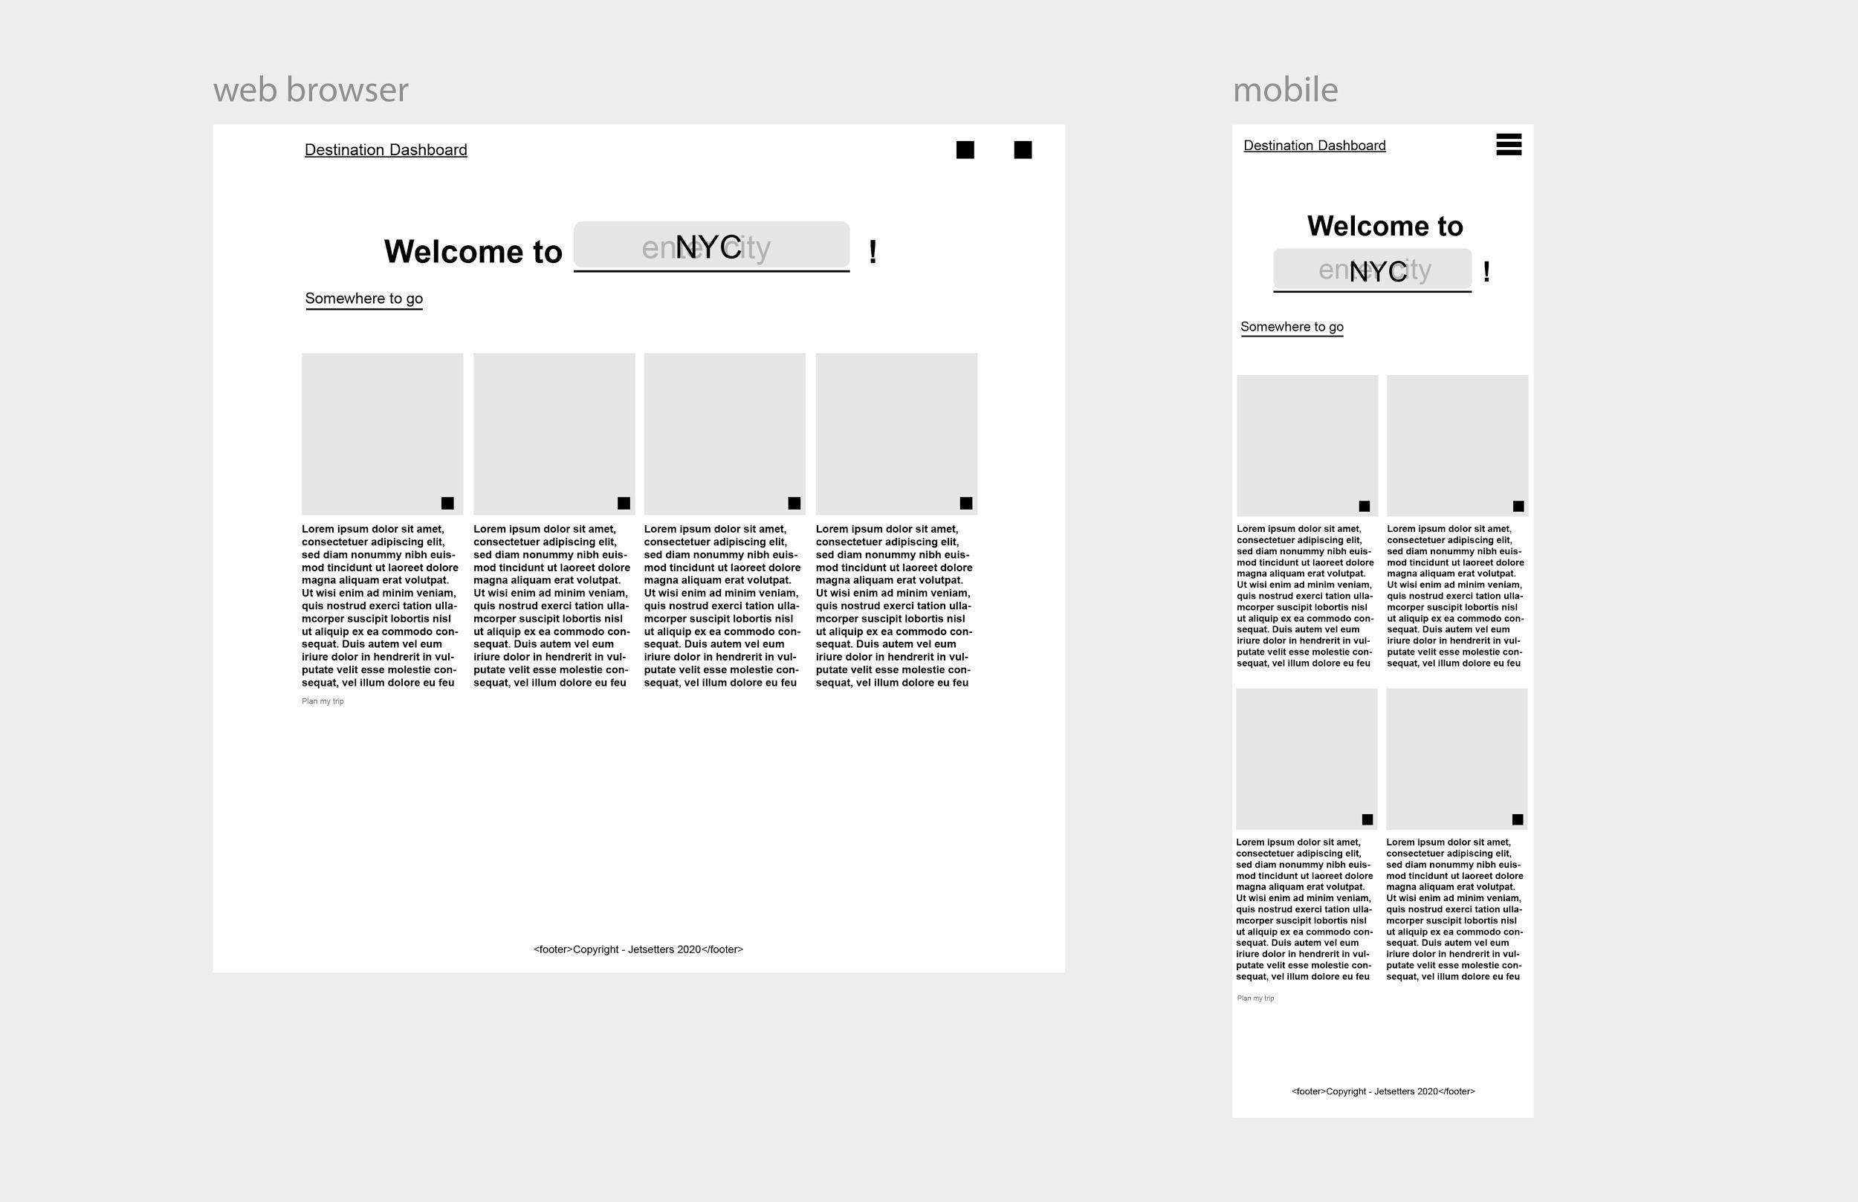
Wireframe development

Slide 13
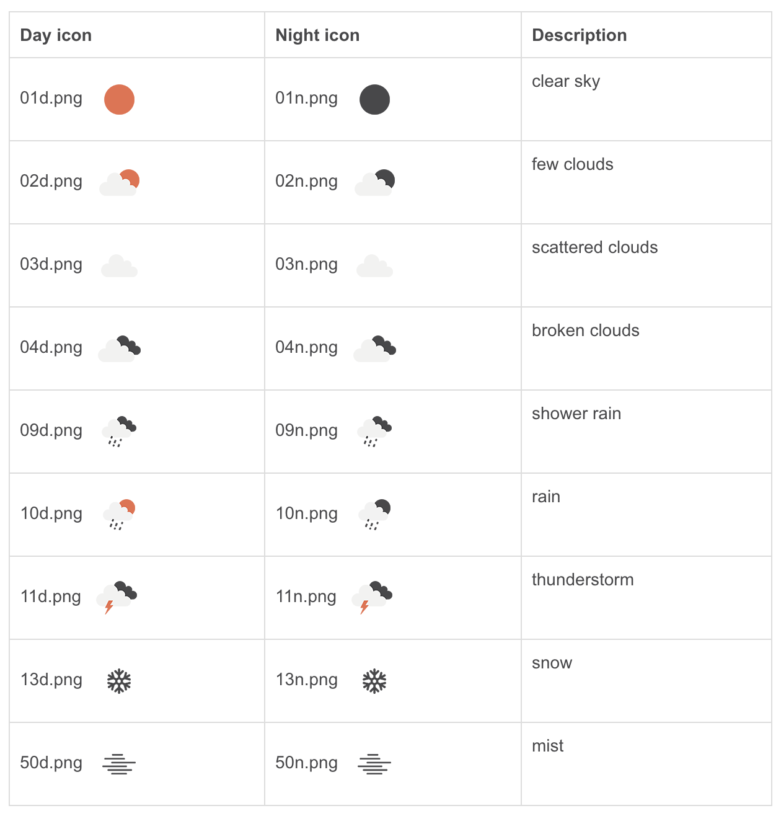





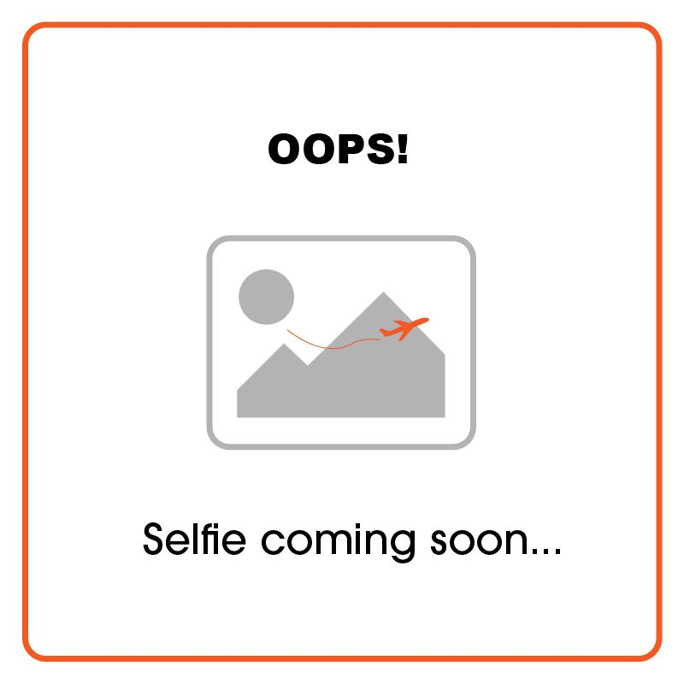
Brand and Asset Development
Icon from OpenWeather API:
Icons further developed for project:
Group ID 235: Rain
Group ID 600: Snow
Group ID 700: Atmosphere
Group ID 800 : Clear
Group ID: Else
Placeholder

Slide 14
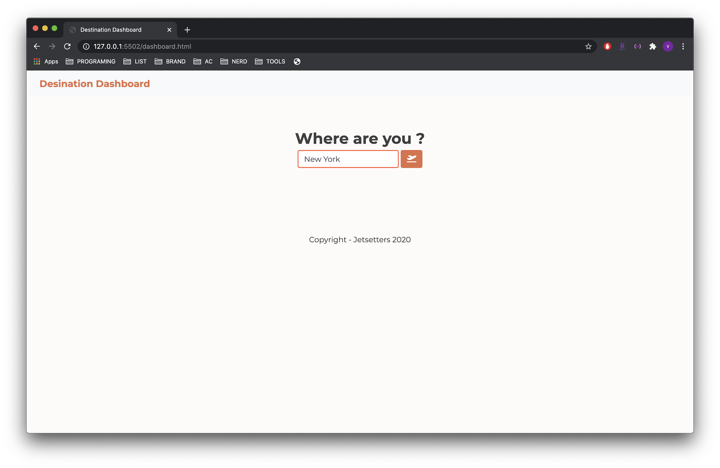
Home

Slide 15
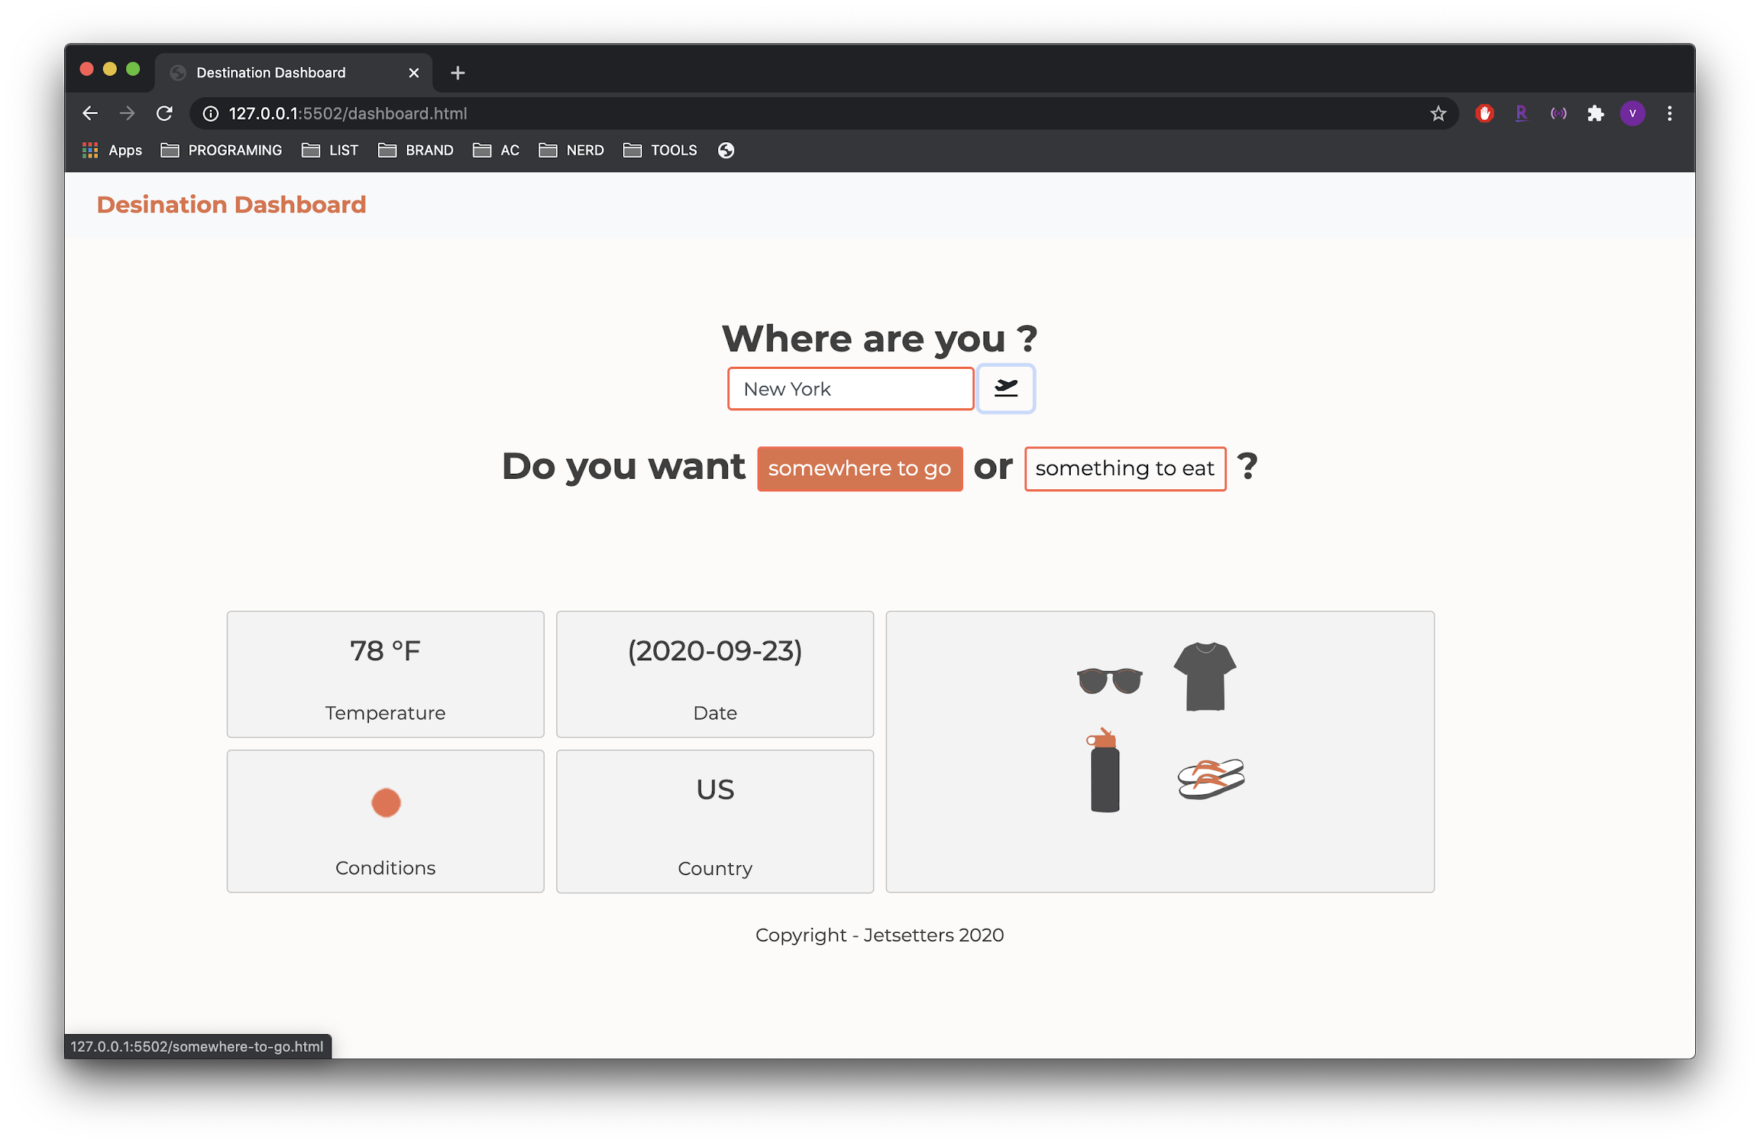
Dashboard

Slide 16
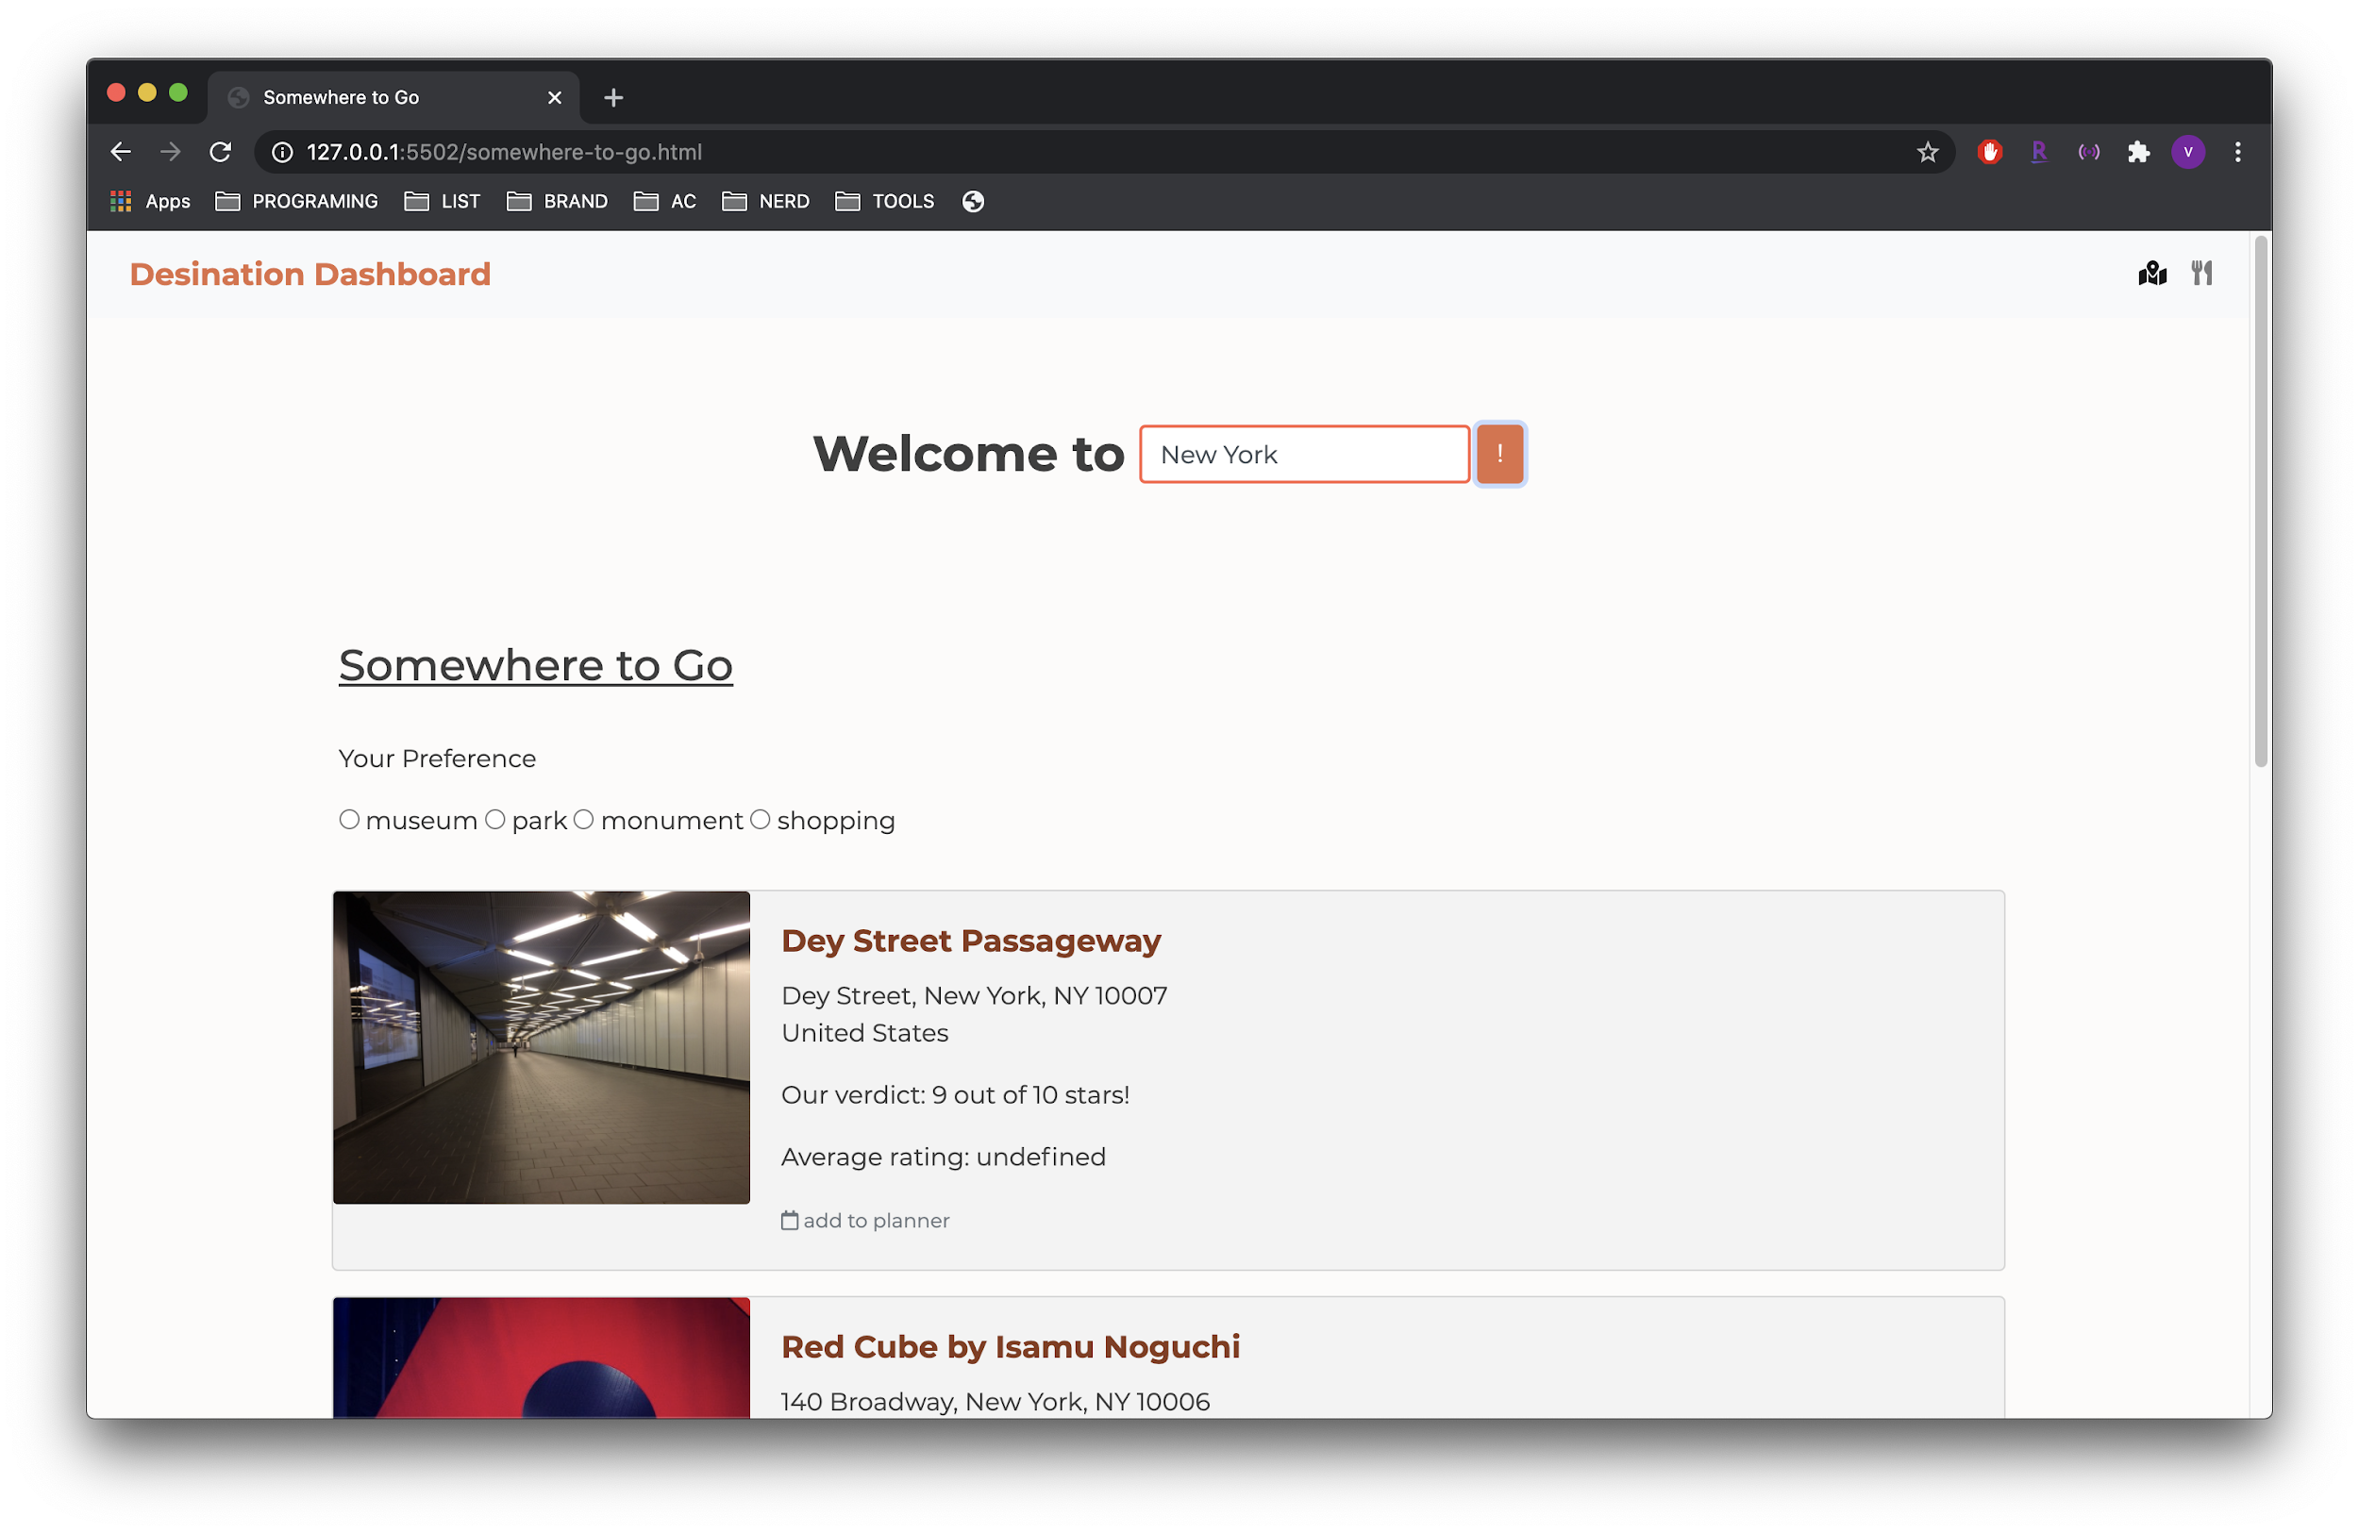
Somewhere to Go

Slide 17
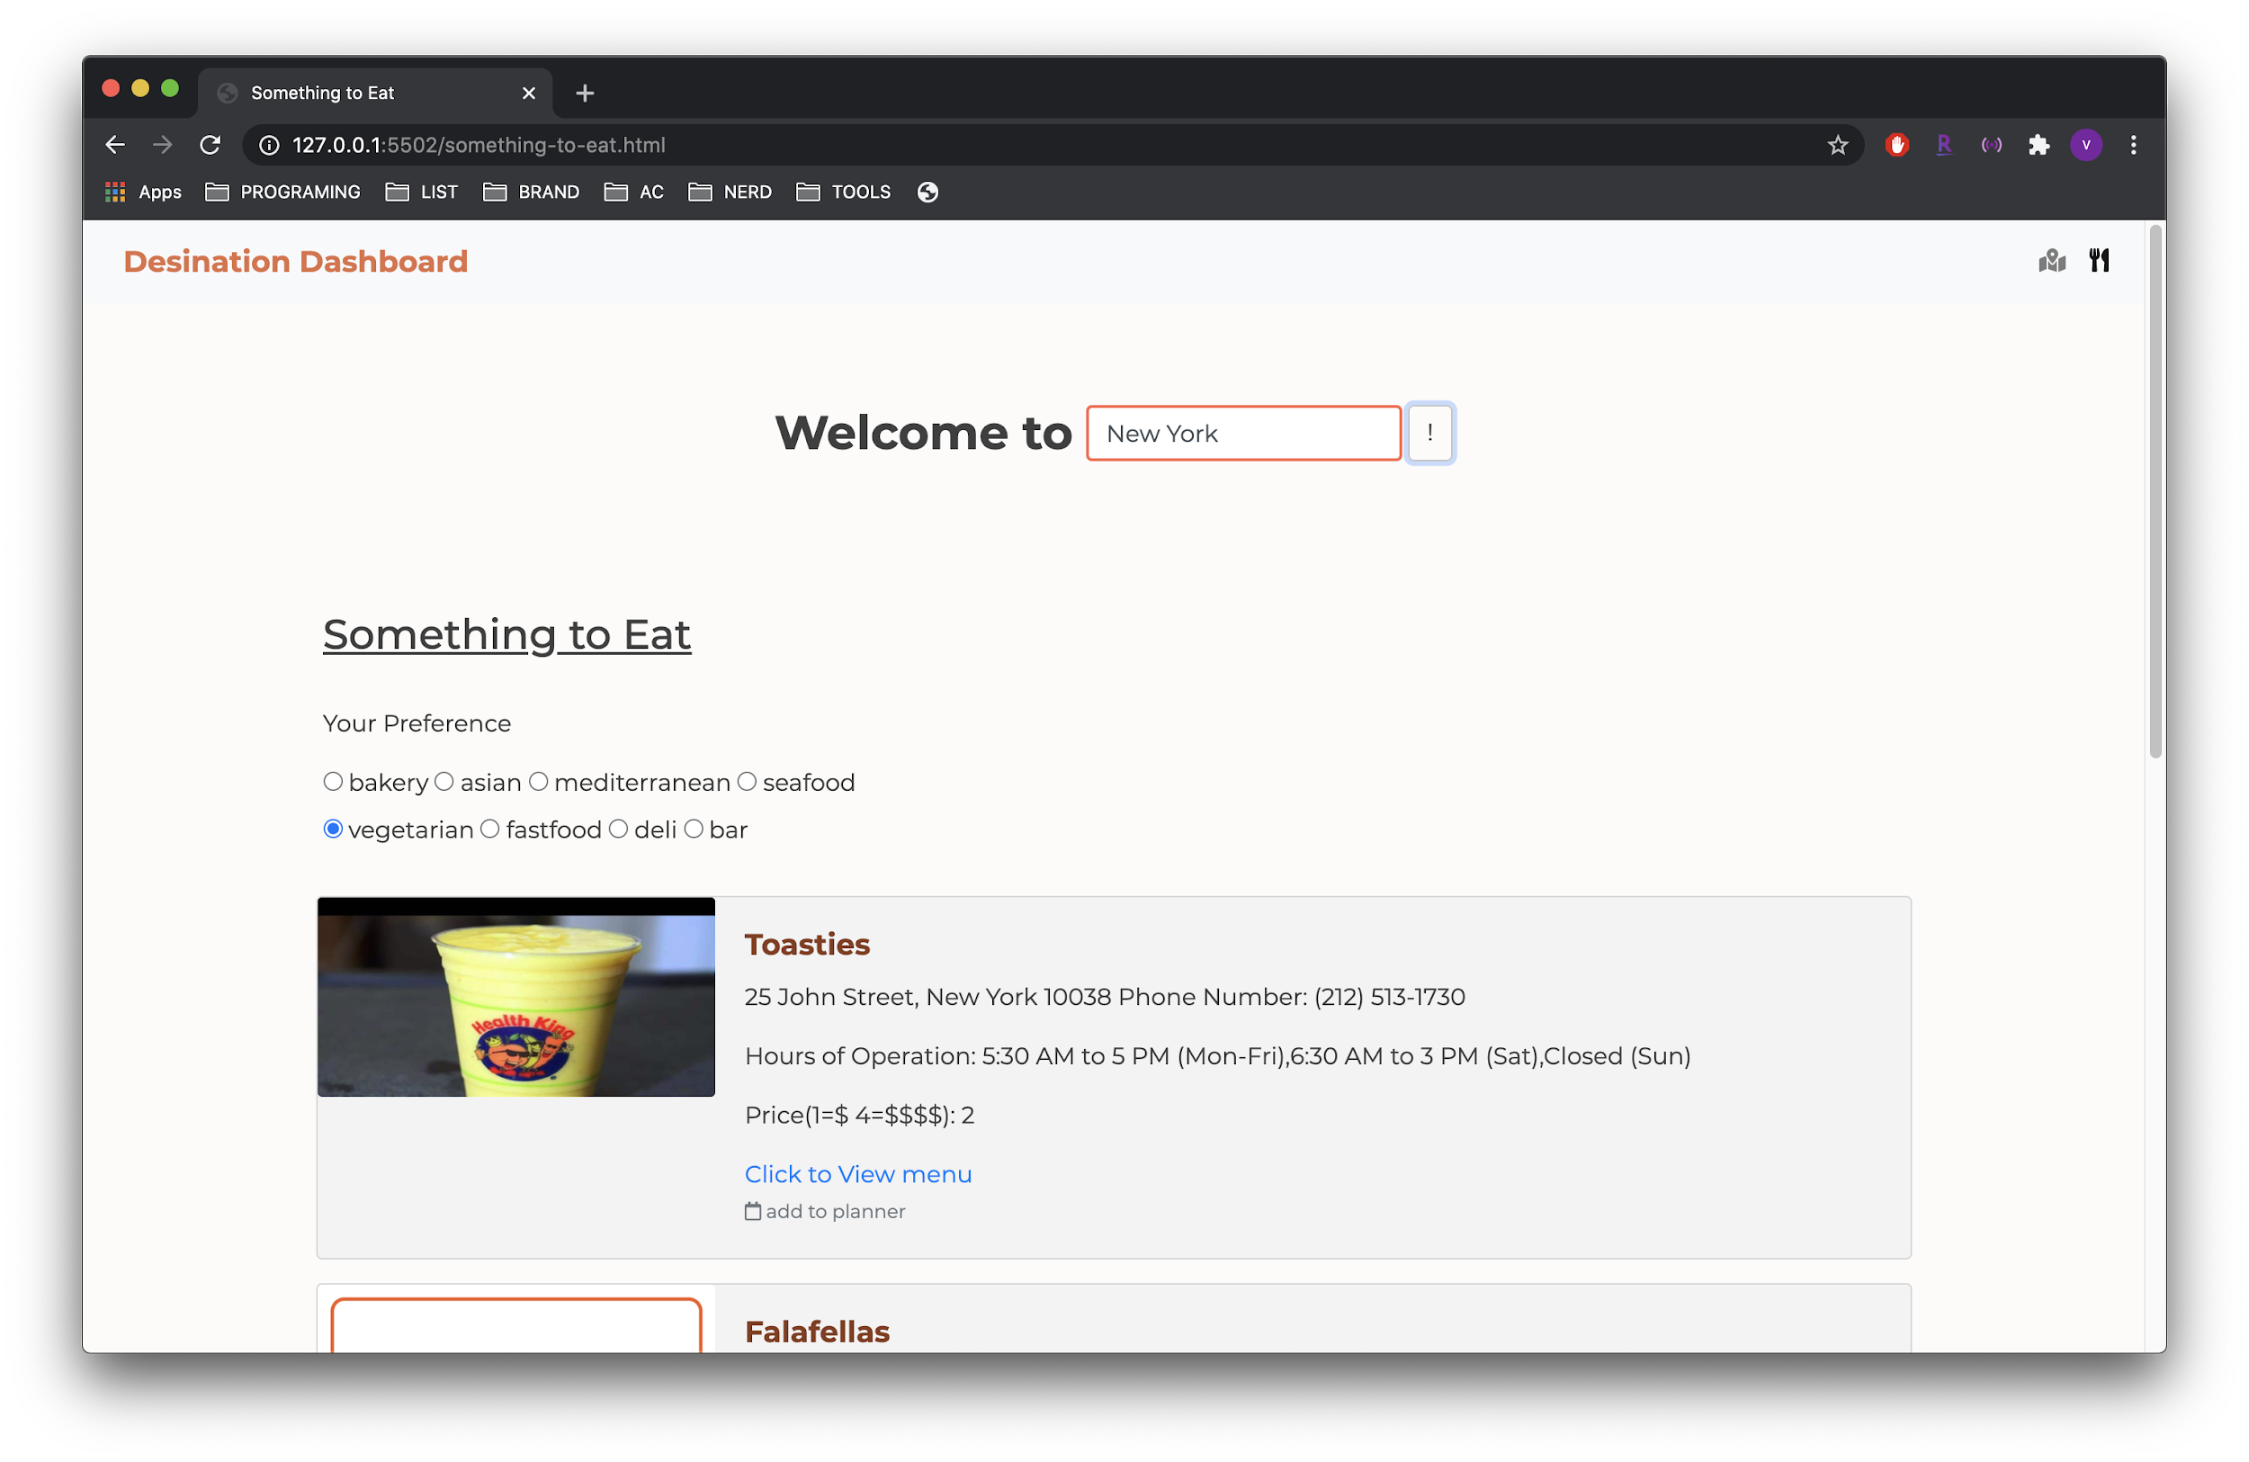
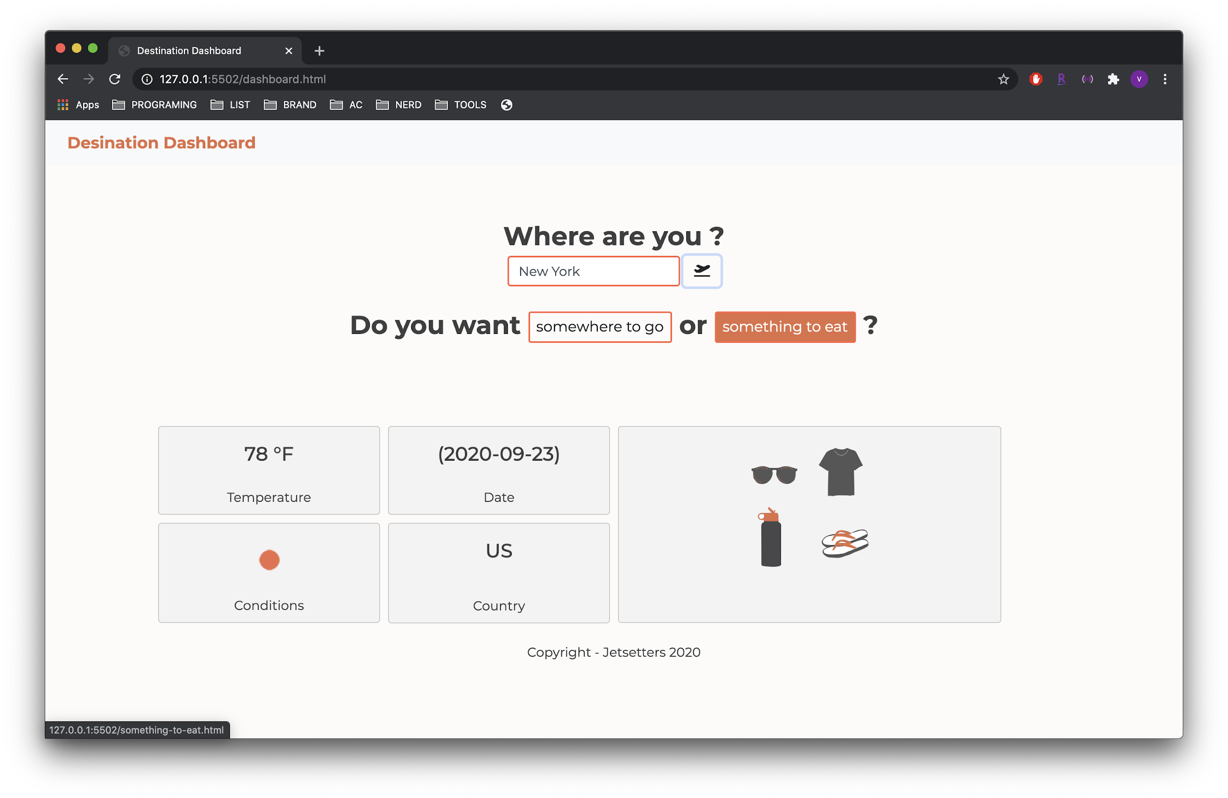
Something to Eat

Slide 18
Challenges

Slide 19
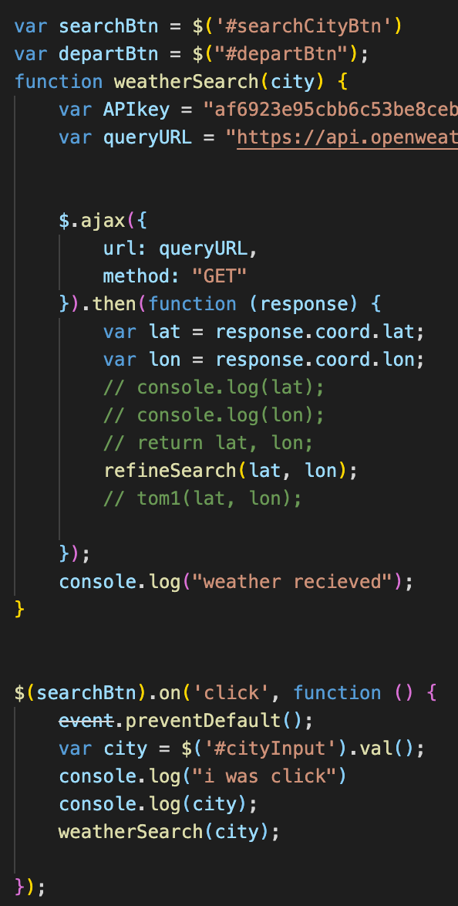
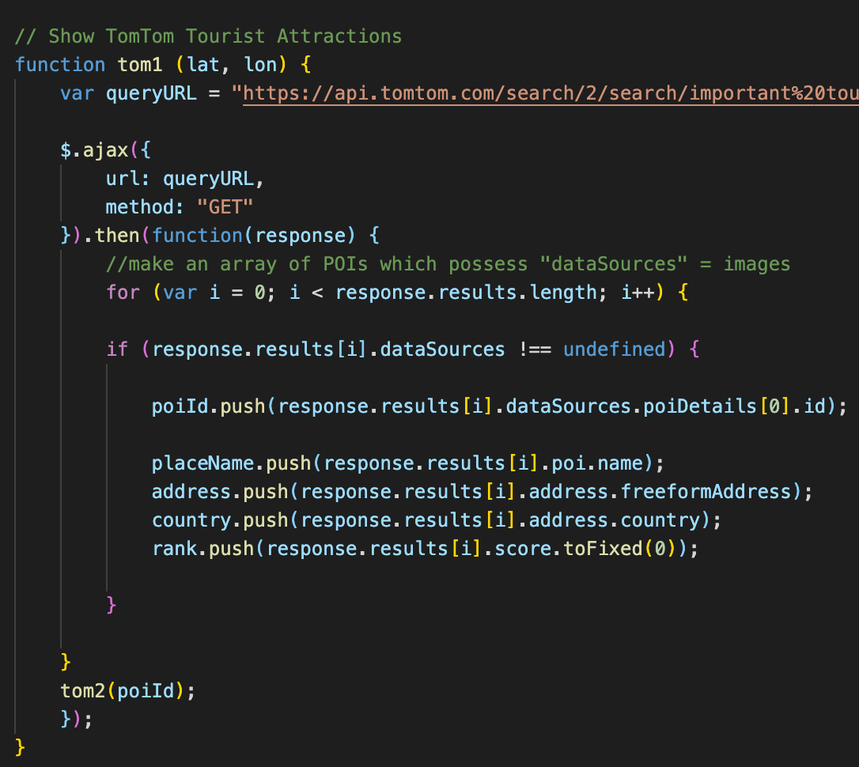
Fetch data from multiple APIs with 1 button
Functions stop each other from running
Define new variables from a response to feed into other API calls while also appending targeted results onto the page.

Slide 20
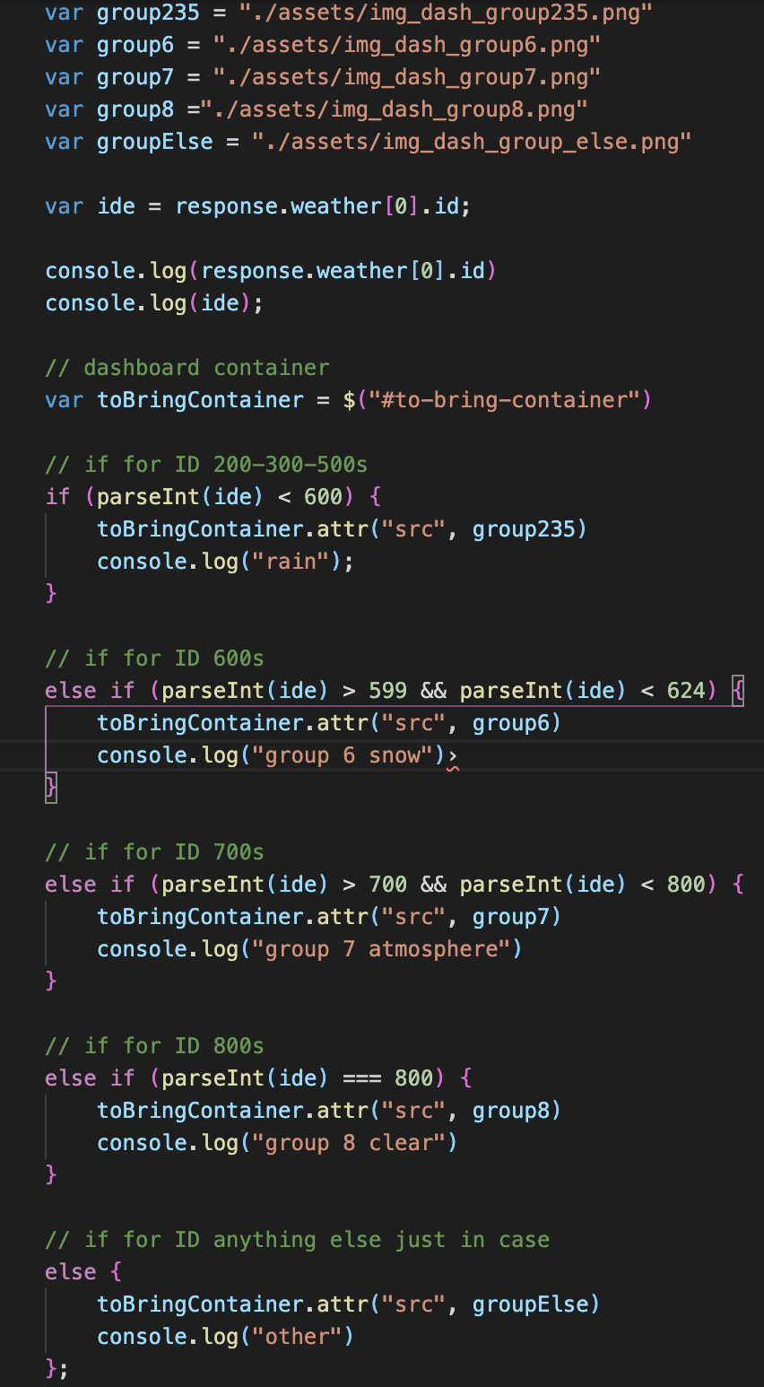
Appending graphics on dashboard
Using response call data to trigger custom corresponding graphics
For zomato API , the challenge of giving img src attributes a .png image

Slide 21
Team developing environment
Resolution:
Developing with flexibility and compatibility in mind
Introduce placeholders and comments
Comment out entire documents during team debugging sessions to isolate problems
Working in local branches and updating project board.
Multiple parallel .js files being developed simultaneously
Communicating code written across the team to keep everyone on the same page

Slide 22
What's Next?

Slide 23
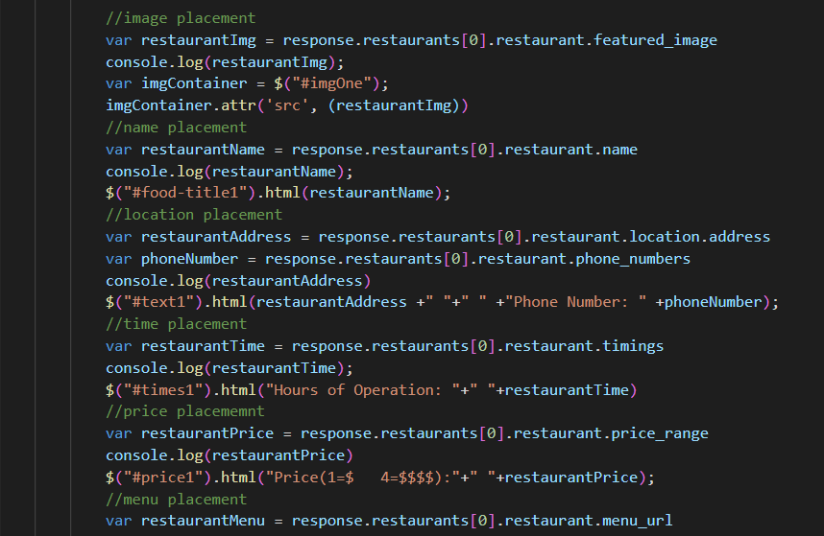
Code Optimization
Insert code or screenshot reference
As developers we are always looking to redesign our code for the most efficient runtime. We try to use least amount of computer memory as possible and increase the runtime. For our projects future development we look to optimize our code especially since we dealt with multiple APIs and the transfer of data from one API to the next.

Slide 24
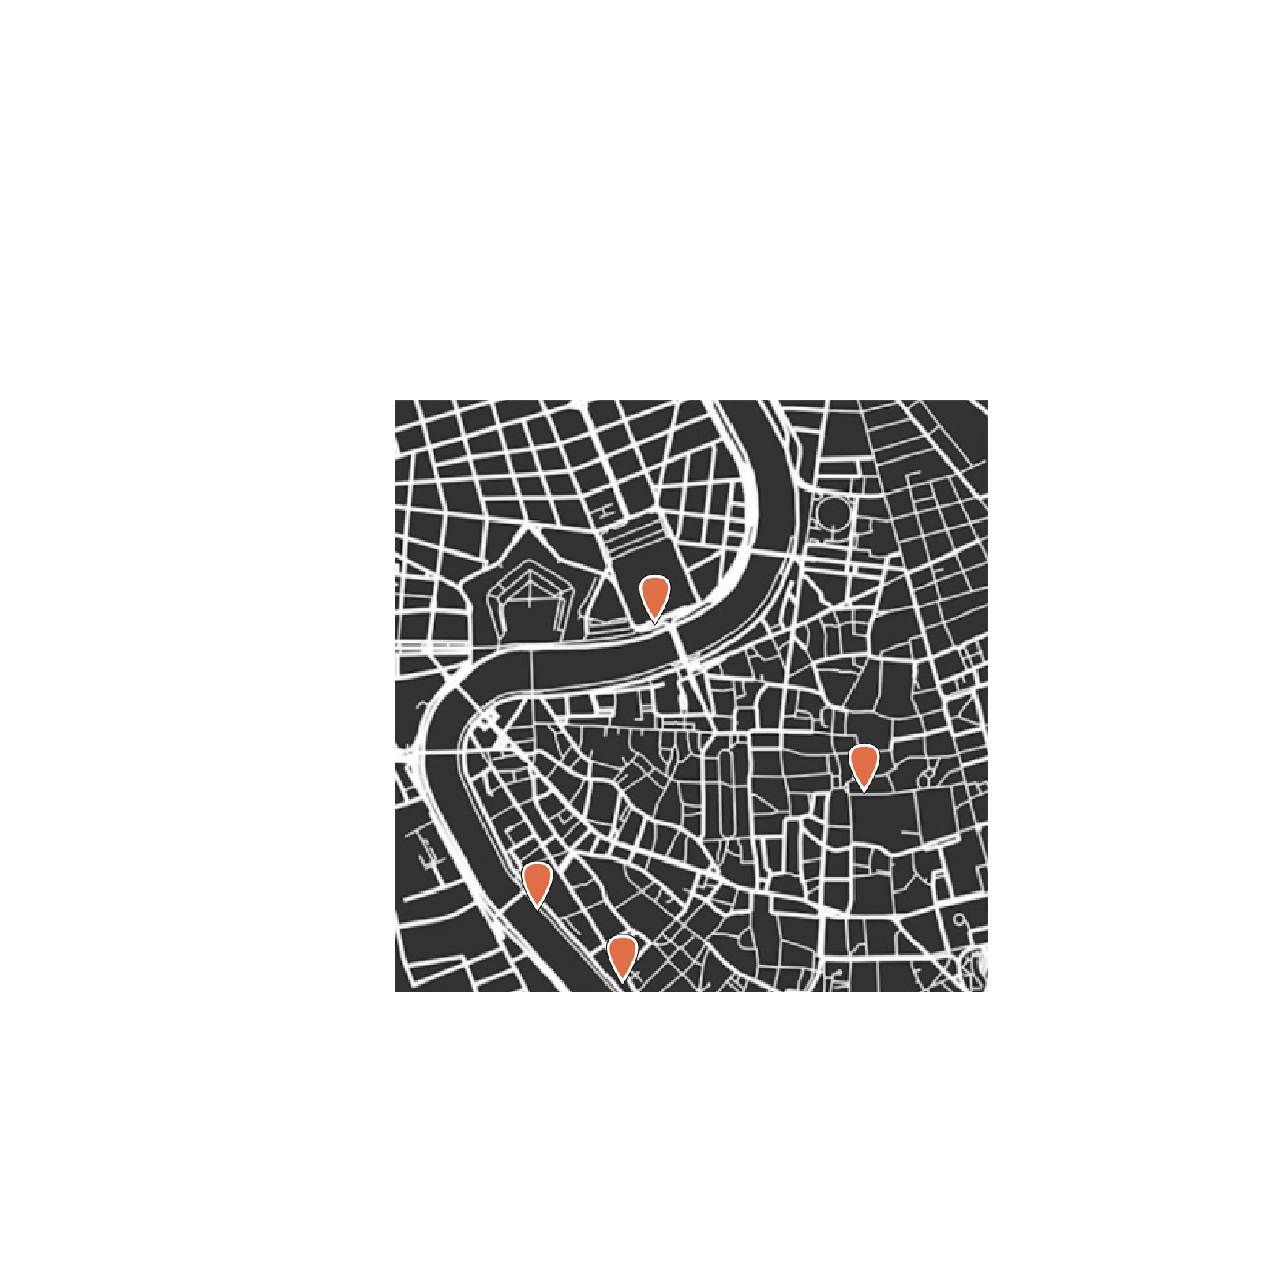
Future Feature Ideas
Itinerary planner: bookmark places into a trip scheduler
Map + location tracking: insert screenshot of branded map
Social platform: build a community by sharing travel tips and ideas
Pick me up: a transportation extension that will provide assistance to get from point A to point B

Slide 25
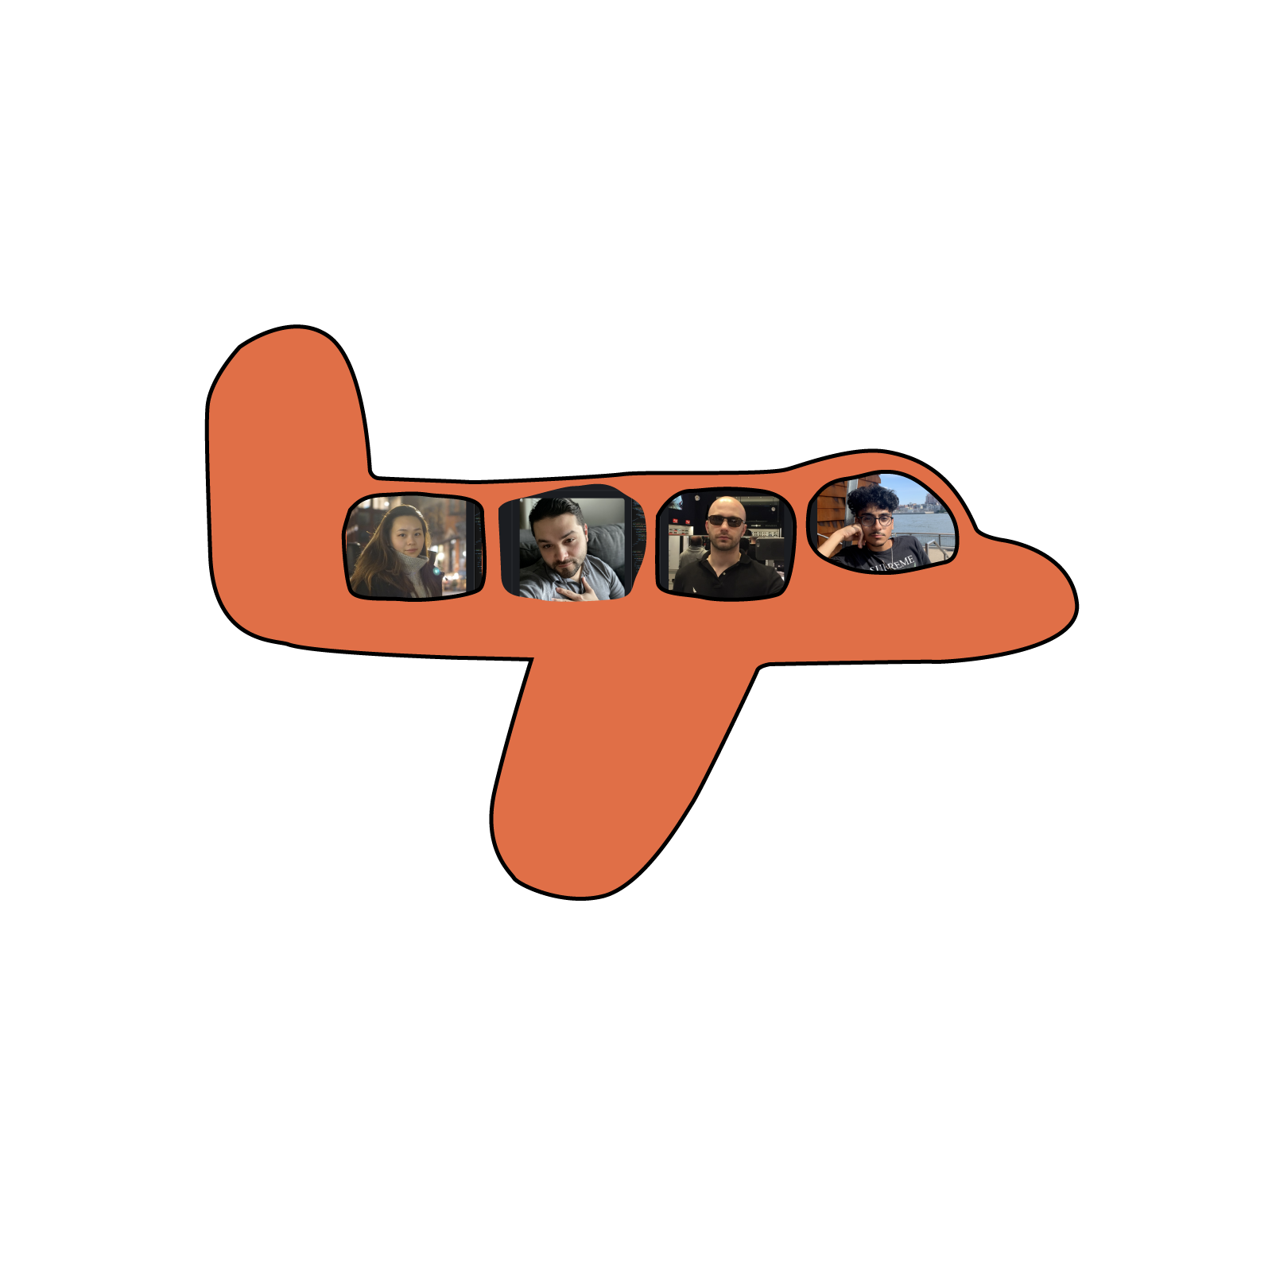
Thank you !

Slide 26
Links
Deployed :
click to visit functioning app :)
GitHub repo:
click to visit repo :)

